Slide 1
Talent Engagement
Welcome to UK

Slide 2



Employee number
Employee name
Employee email
Login

Slide 3

Category
TCS in the UK
On boarding formalities
Things to know
Key contacts
Health & Safety in the UK
Workplace behaviours
Search

Slide 4

TCS in UK&I

Slide 5

On boarding formalities
What’s where on Ultimatix
Onsite reporting – Steps
Opening a Bank Account

Slide 6
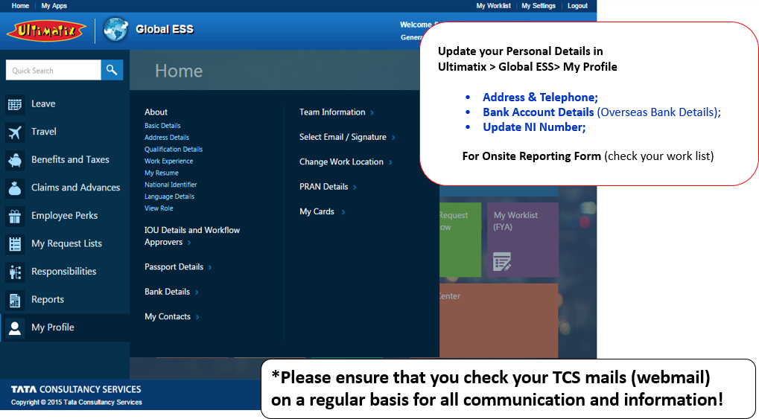
What’s where on Ultimatix

Slide 7
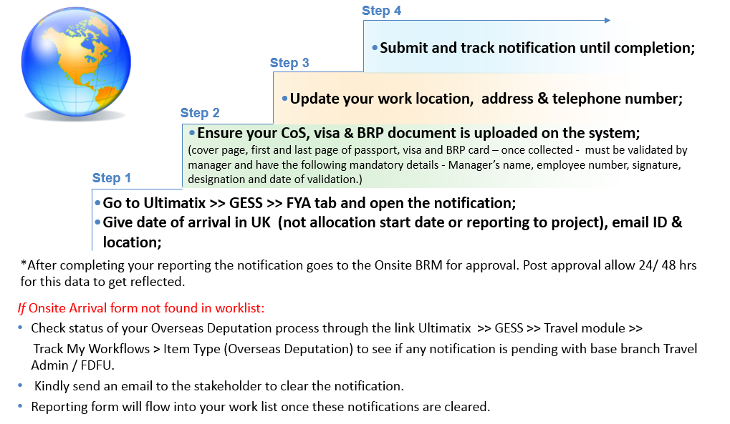
Onsite reporting – Steps

Slide 8
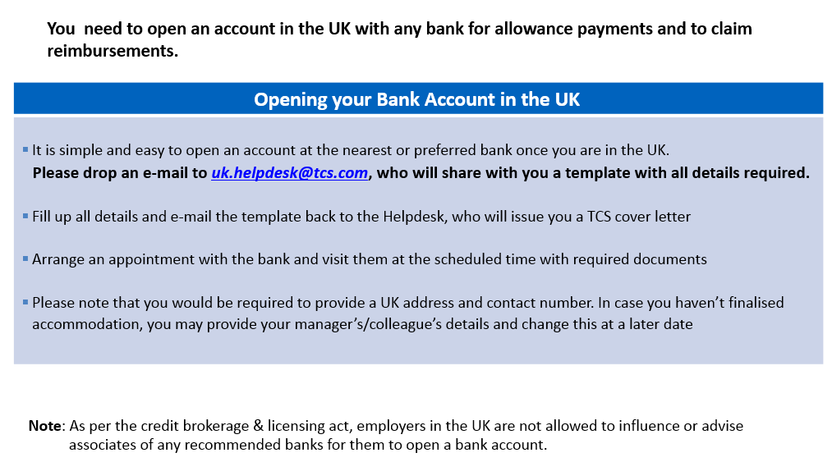
Opening a Bank Account

Slide 9

UK Helpdesk for you…
Please contact uk.helpdesk@tcs.com for any reference/bonafied letters for:
Visitor/business visa
Tenancy agreements
Employment confirmation
NHS

Slide 10
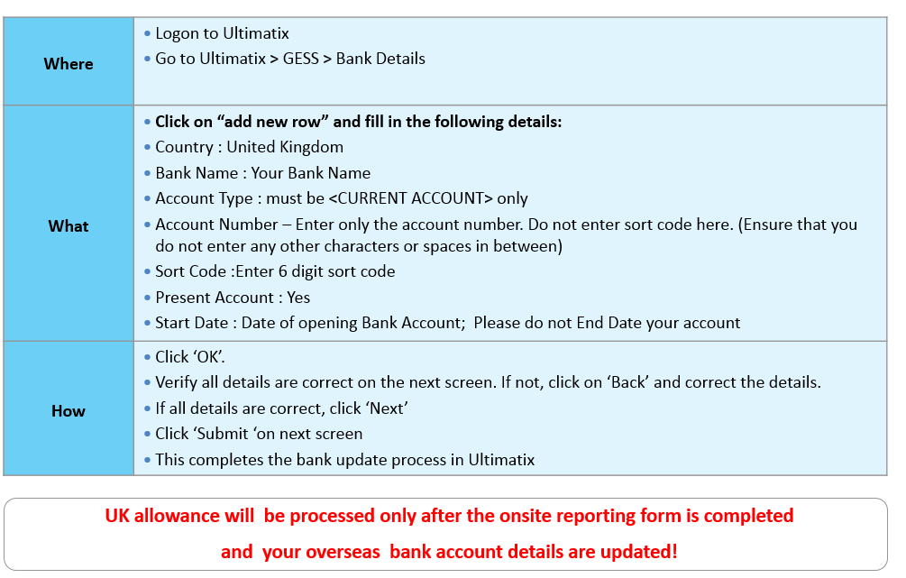
Updating bank account details in Ultimatix

Slide 11
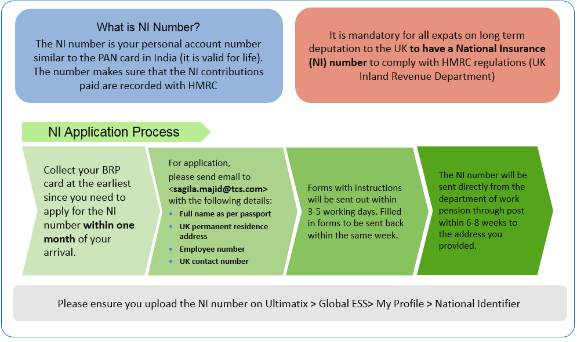
National Insurance Number

Slide 12
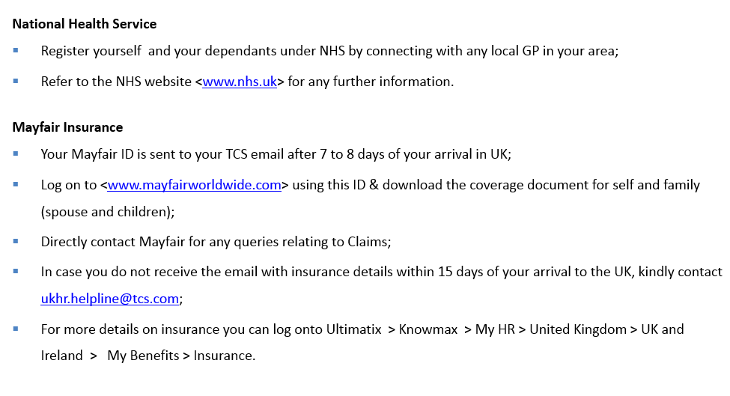
NHS & Mayfair Insurance

Slide 13
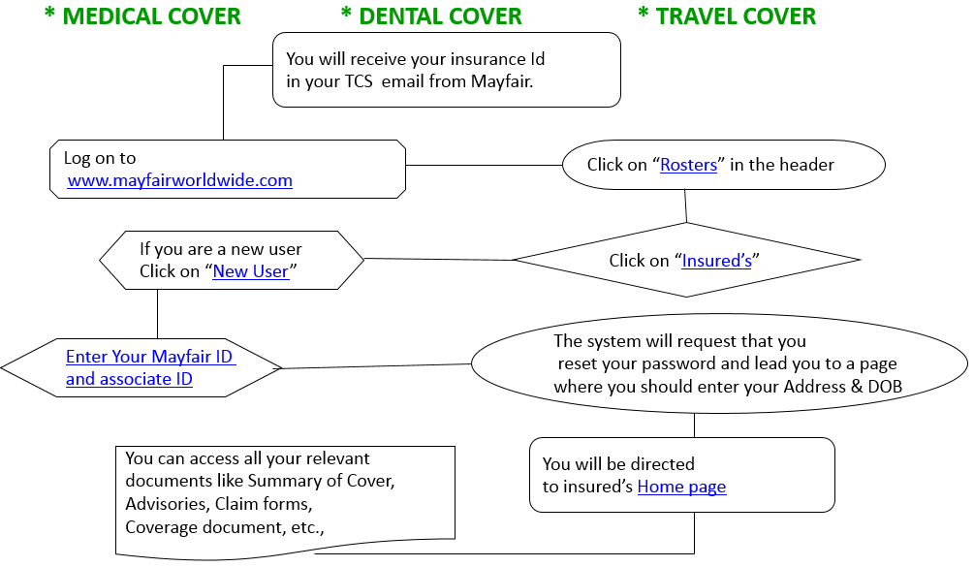
Mayfair Medical Insurance – GOLD Cover

Slide 14

Things to know
HMRC Requirements – Ongoing formality
TCS India Expat Pay Model – UK
Leave policy - Expats
Additional Housing (Rental & Council Tax) Allowance
Pro Tenant: Low Cost Home Search Programme
TCS UK Employee Discount Scheme
Employee Assistance Program (EAP)
HR for you
Communication

